Slide 1

Aggregate Functions

Slide 2
Agenda
Aggregate Function
COUNT
SUM
AVG
MIN
MAX
Aggregate with Group by
Aggregate with Having clause
Having without Group by

Slide 3
Aggregate Functions
Aggregate Functions are all about performing calculations on multiple rows of a single column of a table and returning a single value
The ISO standard defines five (5) aggregate functions namely
COUNT
SUM
AVG
MIN
MAX

Slide 4
Why Use Aggregate Functions?
Aggregate functions allow us to easily produce summarized data from our database
For instance, from our company database , management may require following reports:
Minimum Salary of a particular department
Highest paid employee details
Average salary of HR department

Slide 5
Create Table
Before we go through each of the function one by one. Let’s first have a sample data table we’ll use to demonstrate the usage
CREATE TABLE employee (month INT, emp_id INT, emp_name VARCHAR(15), dept_name VARCHAR(15), salary INT );
INSERT INTO employee VALUES
(1, 101, "Oliver", "HR", 9000),
(1, 102, "George", "IT", 8000),
(3, 103, "Harry", "HR", 20000),
(6, 104, "Jack", "IT", 110123),
(6, 105, "Jacob", "SALES", 3000),
(12,106, "Noah", "SALES", 101000),
(12,107, "Charlie", "IT", 123456),
(Null, 108, "Robert", "IT", 30400);

Slide 6
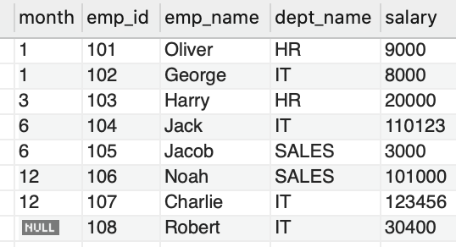
Create Table
The employee table created looks as follows:

Slide 7
COUNT

Slide 8
COUNT Function - Syntax
If you want to count total records matching a condition, then call the COUNT function to get the number
Syntax:
SELECT COUNT([DISTINCT] field_name)FROM target_table[WHERE test_expr];
The COUNT(DISTINCT field_name) returns the number of distinct rows that do not contain NULL values as the result of the expression.

Slide 9
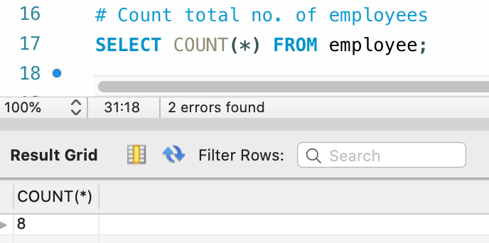
COUNT Function - Example
If you want to count the total number of employees, you can use the count function as follows
SELECT COUNT(*) FROM employee;
Output:
The total number of employees is 8

Slide 10
SUM

Slide 11
SUM Function - Syntax
The SUM function gets total a set of values
Syntax:
SELECT SUM(field_name)FROM target_table[WHERE test_expr];
This is the column or expression that will be summed

Slide 12
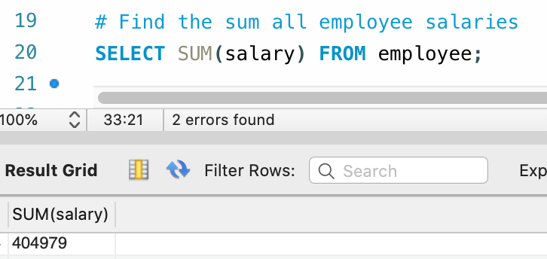
SUM Function - Example
Below is the query to find the sum of all employee salaries using sum() function
SELECT SUM(salary) FROM employee;
Output:
The total sum of salary of all the employees is 404979

Slide 13
AVERAGE (AVG)

Slide 14
AVG Function - Syntax
The AVG function returns the average of a set of values
Syntax:
SELECT AVG(field_name) FROM target_table [WHERE test_expr];
This is the column or expression that will be averaged

Slide 15
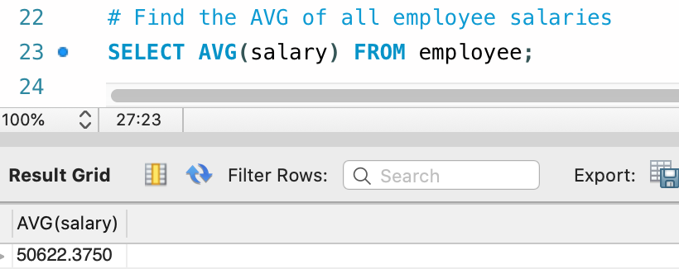
AVG Function - Example
Find the average of all employee salaries, using the AVG function as follows
SELECT AVG(salary) FROM employee;
Output:
The average salary of all employees is 50622.3750

Slide 16
MINIMUM (MIN)

Slide 17
MIN Function - Syntax
The MIN function returns the minimum from a set of value
Syntax:
SELECT MIN(field_name)FROM target_table [WHERE test_expr];
This is the column or expression that will give the minimum value of specific column

Slide 18
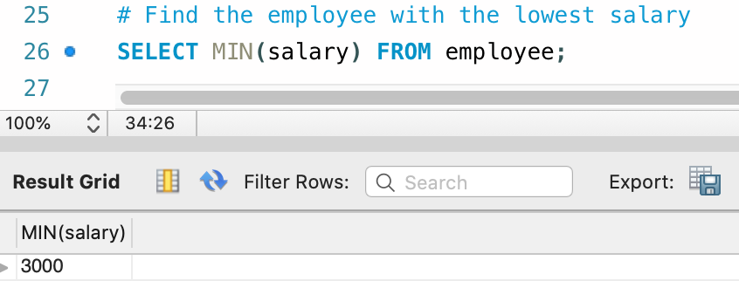
MIN Function - Example
Find the lowest salary received by an employe using the MIN function as follows
SELECT MIN(salary) FROM employee;
Output:
The minimum salary of the employee is 3000

Slide 19
MAXIMUM (MAX)

Slide 20
MAX Function - Syntax
The MAX function returns the maximum from a set of values
Syntax:
SELECT MAX(field_name)FROM target_table[WHERE test_expr];
This is the column or expression that will give the maximum value

Slide 21
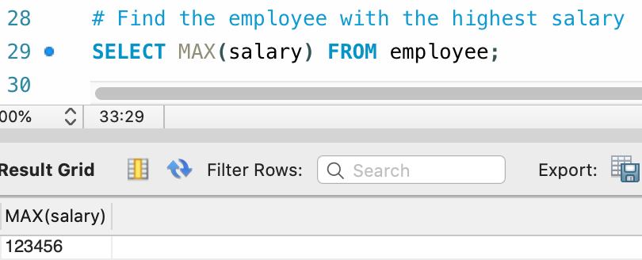
MAX Function - Example
Find the highest salary received by an employee using the MAX function as follows
SELECT MAX(salary) FROM employee;
Output:
The maximum salary of the employee is 123456

Slide 22

The aggregate function discussed so far returns zero when no matching rows exist in the table

Slide 23
Grouped Queries

Slide 24
Group by Function - Syntax
The GROUP BY statement groups rows that have the same values into summary rows
Syntax:
SELECT statements... GROUP BY column_name1[,column_name2,...] [HAVING condition];
"[HAVING condition]" is optional; it is used to restrict the rows affected by the GROUP BY clause
‘GROUP BY” column_name1" is the clause that performs the grouping based on column_name1.
"[,column_name2,...]" is optional; represents other column names when the grouping is done on more than one column.

Slide 25
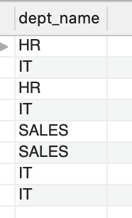
Grouping using Single Column
Execute a simple query that returns all the department entries from the empl table
SELECT dept_name from employee;
Output:
Gives the single group of dept_name column

Slide 26
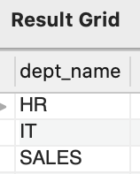
Grouping using Single Column
A GROUPBY function to display unique departments in the office:
SELECT dept FROM empl GROUP BY dept;
Output:
There are 3 unique departments, namely HR, IT, and SALES

Slide 27
Aggregation with Group by Clause

Slide 28
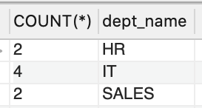
Count Aggregation - Group By
Count the number of employees, in each department, using the Group By clause along with the count aggregate function as follows
SELECT COUNT(*), dept_name FROM employee GROUP BY dept_name;
Output:
Out of 8 employees, 2 employees belong to HR department, 4 belongs to IT department and 2 employees belongs to SALES department

Slide 29
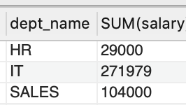
SUM Aggregation - Group By
Use the sum function to find the sum of salaries in each department as follows
SELECT dept_name, SUM(salary) FROM employee GROUP BY dept_name;
Output:

Slide 30
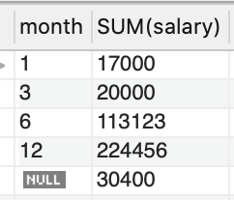
SUM Aggregation - Group By
Find the month-wise sum of salaries using the sum function as follows
SELECT month, SUM(salary) FROM employee GROUP BY month;
Output:

Slide 31
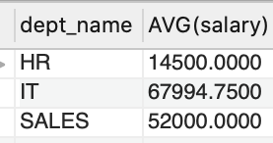
AVG Aggregation - Group By
Find the average of salaries in each department, using AVG function as follows
SELECT dept_name, AVG(salary) FROM employee GROUP BY dept_name;
Output:

Slide 32
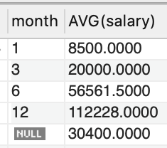
AVG Aggregation - Group By
Find the month-wise average of salaries by using the AVG function as follows
SELECT month, AVG(salary) FROM employee GROUP BY month;
Output:

Slide 33
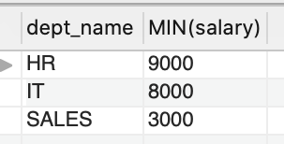
MIN Aggregation - Group By
Find the lowest salary in each department, by using the MIN function as follows
SELECT dept_name, MIN(salary) FROM employee GROUP BY dept_name;
Output:

Slide 34
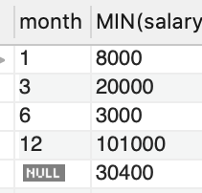
MIN Aggregation - Group By
Find the month-wise minimum salary, by using the MIN function as follows
SELECT month, MIN(salary) FROM employee GROUP BY month;
Output:

Slide 35
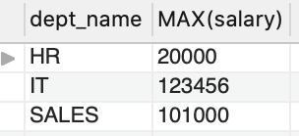
MAX Aggregation - Group By
Find the highest salaries in each department using the MAX function as follows
SELECT dept_name, MAX(salary) FROM employee GROUP BY dept_name;
Output:

Slide 36
Multiple Grouping Columns

Slide 37
Create Table
Let’s first have a sample data table we’ll use to demonstrate the usage
CREATE TABLE employee1 (joining_month INT, emp_id INT,
emp_name VARCHAR(15), dept_name VARCHAR(15), salary INT );
INSERT INTO employee1 VALUES
(1, 101, "Oliver", "HR", 9000),
(1, 102, "George", "IT", 8000),
(1, 103, "Harry", "HR", 20000),
(3, 104, "Jack", "IT", 110123),
(6, 105, "Jacob", "SALES", 3000),
(6,106, "Noah", "SALES", 101000),
(3,107, "Charlie", "IT", 123456),
(Null, 108, "Robert", "IT", 30400);

Slide 38
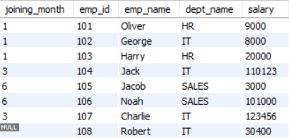
Create Table
The employee1 table created looks as follows:

Slide 39
Multiple Grouping Columns
A GROUP BY clause can contain two or more columns- or, in other words, a grouping can consist of two or more columns

Slide 40
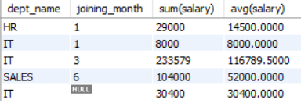
Multiple Grouping Columns
Get sum of salaries and as well as average of all employees in each dept as per the joining month
SELECT dept_name, joining_month, SUM(salary), AVG(salary) FROM employee1 GROUP BY dept_name, joining_month;
Output:
Here we are grouping salary data by using multiple columns : dept & joining month

Slide 41



All grouping columns that are given in the select list must be included in the group by clause in only_full_group_by mode
Select dept_name, joining_month, sum(salary) From employee1 group by dept_name;
Select dept_name, joining_month, sum(salary) From employee1 group by dept_name , joining_month;
SELECT list is not in GROUP BY clause and contains nonaggregated column 'company.employee.joining_month' which is not functionally dependent on columns in GROUP BY clause; this is incompatible with sql_mode=only_full_group_by

Slide 42
Group by functions should not be included in the group-by clause
Select dept_name, joining_month, sum(salary) From employee1 group by sum(salary);
Select dept_name, joining_month, sum(salary) From employee1 group by dept_name, joining_month;
Error Code: 1056. Can't group on 'sum(salary)'

Slide 43
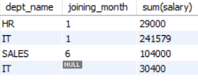
Comparison Conditions cannot be included in the group by clause as they cannot act on grouped result set
Select dept_name, joining_month, sum(salary) From employee1 group by sum(salary) > 10000;
Select dept_name, joining_month, sum(salary) From employee1 group by dept_name, joining_month > 10000;
Error Code: 1111. Invalid use of group function

Slide 44
Some other Restriction on Grouped Queries
WHERE clause with conditions can be issued before the group-by clause in order to filter the records and then apply Group By feature
But , WHERE clause should always mention before the GROUP BY
Grouping columns should have less unique values.
Grouping columns should be primary business entities and facts and should not contain transactional data.
Ex: dept , month – are less unique and summarizing the results are easy for grouping on these columns

Slide 45
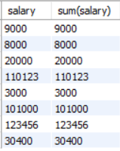
Some other Restriction on Grouped Queries
No Summarized Results
Accurate Summary Results
Select salary, sum(salary) From employee1 group by salary;
Select dept_name, joining_month, sum(salary) From employee1 group by dept_name, joining_month ;

Slide 46
Null Values in Grouping Columns

Slide 47
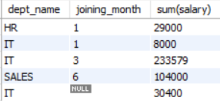
Null Values In Grouping Columns
If joining month of few employees is unknown and NULL exists in the joining_month column, then the salary is still calculated to show aggregate summary of salaries for those NULL values of the joining_month column
Select dept_name , joining_month , sum(salary) From employee1 group by dept_name , joining_month;
Output:
Shows the aggregate summary of salaries for those NULL values of the month.

Slide 48
Aggregation With Having Clause

Slide 49

Aggregation with Having Clause
Find the department where the collective salary is more than 35000 each using aggregation with having clause as below:
Select joining_month, dept_name , sum(salary) From employee1 group by joining_month, dept_name having sum(salary) > 35000;
Output:

Slide 50
Restriction on Grouped Search Condition

Slide 51
Restriction on Grouped Search Condition
Having clause is used along with group-by clause in order to apply conditions for the grouped result set
Having clause should be enclosed with grouped functions on columns that are issued in the Select query

Slide 52
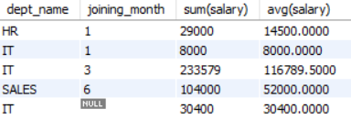
Restriction on Grouped Search Condition
Conditions in having clause should always have at least one grouping function for comparison since it acts on grouped result set.
Select dept_name, joining_month, sum(salary), avg(salary) From employee1
group by dept_name , joining_month having sum(salary) is not null;
Output:

Slide 53
Null values and Grouped Search Condition

Slide 54
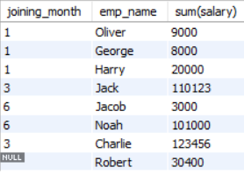
Null Values and Grouped Search Condition
If you want to find full salary details of employee along with the name and month they have joined, where the salary is not a null value
Select joining_month, emp_name , sum(salary) From employee1 group by joining_month having sum(salary) is not null;
Output:
salary details of employee along with the name and month they have joined, where the salary is not a null value

Slide 55
Having Without Group by

Slide 56

Having without Group by
Print one high level summary report of salary that is paid to all employees but not less than 299999. It benefits to quickly review on sum of salaries paid for all the employees in the company is exceeding 299999
Select sum(salary) From employee1 having sum(salary) > 299999;
Output:
The sum salary is 404979

Slide 57
Thank You

